Slide 1

How to execute the IMPC statistical pipeline
Hamed Haseli, June 2023

Slide 2
Stages and Steps
The IMPC statistical pipeline requires 4 steps to complete:
Pre-processing the data and run the analysis (estimated time about 2 weeks)
Run the annotation and transfer pipeline (estimated time about 1 day)
Run the report generating pipeline (estimated time about .5 a day)
Run the extraction of risky genes pipeline (estimated time about 30 minutes)

Slide 3
FAQ
When the pipeline is completed?
When there is no job running under mi_stats user.
Do you expect some errors from the stats pipeline?
Yes, having a few errors is normal. If you see more than few errors, you may want to run the GapFilling pipeline. See Step_1.2_RunGapFillingPipeline.mp4 video

Slide 4
1. Preparing the mp_chooser
This step requires updating the mp_chooser data files from the input data that Federico passes with each data release
Let the path to the mp_chooser.json be EBIHadoopCluster:/hadoop/user/mi_hadoop/impc/dr19.1/output/mp_chooser_json/part-00000-482667f5-0b4e-4a5a-8c62-ac341833df19-c000.txt
Steps:
Copy file above to a temporary directory on codon cluster
Navigate to the directory
Open an R session by typing R in the console
Run the command below:
a = jsonlite::fromJSON(‘absolute path to the file’);save(a,file=‘mp_chooser_20230411.json.Rdata’)
► Running the command above will create a file mp_chooser_20230411.json.Rdata in the working directory (do not change the name or timestamp)
Pull the stats pipeline from https://github.com/mpi2/impc_stats_pipeline
Copy and overwrite the file above in the following directories:
https://github.com/mpi2/impc_stats_pipeline/tree/master/Late%20adults%20stats%20pipeline/DRrequiredAgeing/DRrequiredAgeingPackage/inst/extdata/annotation
https://github.com/mpi2/impc_stats_pipeline/tree/master/Late%20adults%20stats%20pipeline/DRrequiredAgeing/DRrequiredAgeingPackage/inst/extdata/StatsPipeline/jobs/Postgres
Push the repository to GitHub
► You need to rewrite the file in this step (an older version of the file should be already existing there)

Slide 5
1 (continue). Copying the parquet files to the codon cluster
Steps:
Create a directory on codon:/nfs/production/tudor/komp/impc_statistical_pipeline/IMPC_DRs/ stats_pipeline_input_drXX.y
Open an R session by typing R in the console
Run the following command. This will update the pipeline to the latest version. command:source('https://raw.githubusercontent.com/mpi2/impc_stats_pipeline/master/Late%20adults%20stats%20pipeline/DRrequiredAgeing/DRrequiredAgeingPackage/inst/extdata/StatsPipeline/UpdatePackagesFromGithub.R’)
Exit R by typing q()
In the same directory run:
bsub –e StatsPipelineError –o StatsPipelineOutput “R –e ‘DRrequiredAgeing:::StatsPipeline(DRversion=XXX)’”
► replace the DR version in XXX
The above steps will execute the pipeline, prepare the data and perform the statistical analysis. This normally takes about 2 weeks

Slide 6
Step 1 FAQ
How to figure out the pipeline is running?
The easiest way to figure out that the pipeline is running is to execute bjobs and in the first 4 days of running the pipeline there should be less than 20 jobs running and otherwise there should be 5000+ jobs running on the codon cluster.
How to figure out if this step is finished?
When there is no jobs running of the cluster, this means the pipeline is finished
How to get logs from the pipeline?
The short answer: The easiest way to access the logs is to refer to <stats pipeline directory>/SP/logs after the completion of the pipeline
The long answer (only If the pipeline failed in the middle of the process). The log files are distributed for jobs and there are not in a single place. You can use the following command (in UNIX bash) to copy the log files into your destination directory
cd <stats pipeline directory>/SP
find ./*/*_RawData/ClusterOut/ -name *ClusterOut -type f |xargs cp --backup=numbered -t <path to a log directory>
find ./*/*_RawData/ClusterErr/ -name *ClusterErr -type f |xargs cp --backup=numbered -t <path to a log directory>

Slide 7
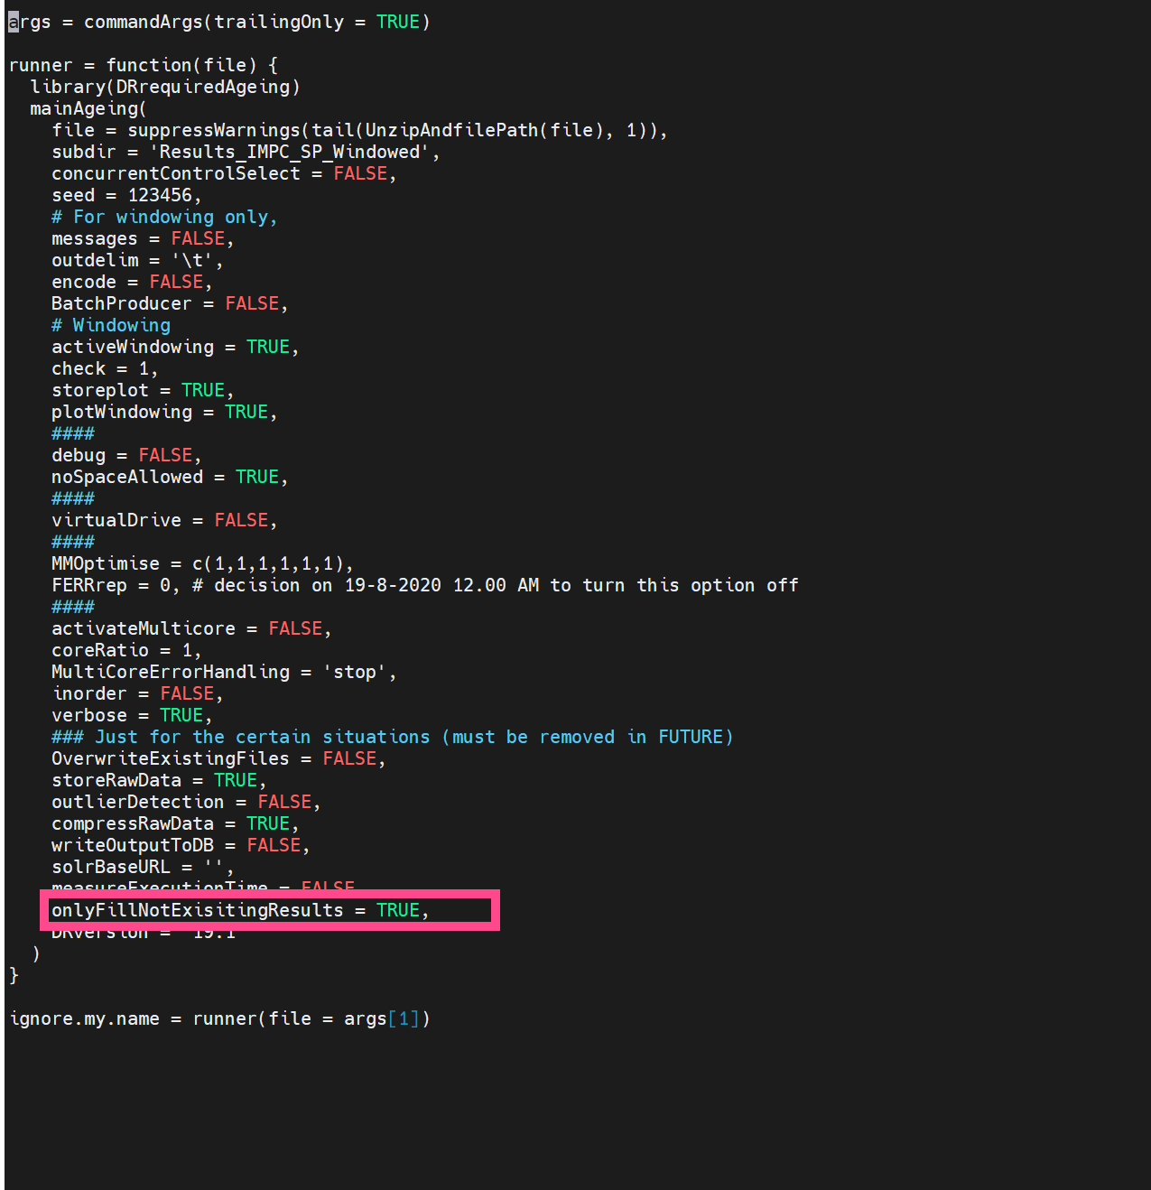
Only if you need to run the gap filling pipeline
There are very rare cases that the stats pipeline fails with unknown reason. The easiest way to continue the pipeline from where it failed is to use the GapFilling Pipeline. This is the same as running the pipeline by going into <stats pipeline directory>/SP/jobs and executing AllJobs.bch but before that you need to edit function.R and change the parameter “onlyFillNonExistingResults” to TRUE like the image on the right hand side.
Then run the pipeline by executing ./AllJobs.bch and wait for the pipeline to fill the missing analysis. This can take up to 2 days.

Slide 8
Run the annotation and transfer pipeline
This step assigns the annotations to each StatPacket and transfers the files to Hadoop cluster for the downstream processes.
Steps:
Navigate to :/nfs/production/tudor/komp/impc_statistical_pipeline/IMPC_DRs/stats_pipeline_input_drXX.y/SP/jobs/Results_IMPC_SP_Windowed
Open an R session by typing R in your console (you need to make sure that this session is alive during the process or you can make a screen to keep it alive)
Run the following command in the R session:
DRrequiredAgeing:::IMPC_HadoopLoad(prefix=‘DRXX’,transfer=TRUE)
► The command above uses the power of LSF cluster to assign the annotations to the StatPackets and transfers the files to the Hadoop cluster. The files will be transferred to Hadoop:/hadoop/user/mi_stats/impc/statpackets/DRXX
► The most complex part of this process is that some files will fail to transfer and you need to use scp command to transfer files to the Hadoop cluster manually
► When you are sure that all files are there, you can share the path with Federico.

Slide 9
Annotation pipeline FAQ
How to figure out that the pipeline is finished?
When there is no job running on the cluster
Where on the Hadoop cluster are files?(this path should be passed to Federico)
They are in (*YYY)Hadoop:/hadoop/user/mi_stats/impc/statpackets/DRXX.YY/ [a date in dmyyyy format]
How to figure out if a file has not been transferred (successfully) to the Hadoop cluster?
If a file in ZZZ* directory is gzipped then it has been successfully transferred
*ZZZ.Codon:nfs/production/tudor/komp/impc_statistical_pipeline/IMPC_DRs/stats_pipeline_input_drXX.YY/SP/jobs/Results_IMPC_SP_Windowed/AnnotationExtractorAndHadoopLoader/tmp
How to transfer the failed files into Hadoop?
First cd to ZZZ (see above path) and move the not gzipped files into YYY using SCP command.
Alternatively, you can run the following command in R (make sure that you open an R session in the ZZZ directory)
DRrequiredAgeing:::HadoopReTransferSCP(prefix=‘DRXX.YY/tmpDir’)
Using the command above will clean up all .gz files (which were already transferred successfully) from the directory and transfer the other files into a directory tmpDir on Hadoop. Then I move the files into the YYY directory. The reason I do not transfer them directly to YYY is that the Hadoop HDFS does not allow rewriting files and if the file is already there, then the process will fail.

Slide 10
Run the report generating pipeline
This process is to create statistical reports that are normally used by the IMPC working groups
Steps:
Navigate to :/nfs/production/tudor/komp/impc_statistical_pipeline/IMPC_DRs/stats_pipeline_input_drXX.y/SP/jobs/Results_IMPC_SP_Windowed
Allocate a high memory machine on cluster and initialise an interactive shell by following the following command: bsub –M 300000 –e errReportGeneratingPipeline –o outReportGeneratingPipeline –Is /bin/bash
Open an R session by typing R in your console (you need to make sure that this session is alive during the process or you can make a screen to keep it alive)
Run the following commands in the R session:
DRrequiredAgeing:::IMPC_statspipelinePostProcess()
DRrequiredAgeing::: ClearReportsAfterCreation()
► The commands above will generate two csv files in the :/nfs/production/tudor/komp/impc_statistical_pipeline/IMPC_DRs/stats_pipeline_input_drXX.y/SP/jobs/Results_IMPC_SP_Windowed directory for the unidimentional and categorical results. The files can be gzip and moved to the FTP directory. You can decorate and format the files by using one of the formatted files in the previous data releases.

Slide 11
Run the extraction of risky genes pipeline
This process generates a list of risky genes to check manually
Steps:
Allocate a machine on codon cluster, bsub –M 8000 –Is /bin/bash
Open an R session by typing R in the console
Run the following command in the console:
DRrequiredAgeing:::extractRiskyGenesFromDRs(‘path to the gzip report from the NEW release’, ‘path to the new report on the OLD release’)
You may need to transfer the old reports to a path to make it accessible for the pipeline
► The output of this process is a file (in the current directory) RiskyGenesToCheck_[DATE].txt with each line a gene that should be manually checked

Slide 12
END

